Slide 1
BUS 297D: Data Mining
Professor David Mease
Lecture 2
Agenda:
1) Assign Homework #1 (Due Thursday 9/10)
2) Finish lecture over Chapter 2
3) Start lecture over Chapter 3

Slide 2
Homework 1
Homework 1 is at
http://www.cob.sjsu.edu/mease_d/bus297D/homework1.html
It is due Thursday, September 10 during class
It is work 70 points
It must be printed out using a computer and turned in during the class meeting time. Anything handwritten on the homework will not be counted. Late homeworks will not be accepted.

Slide 3
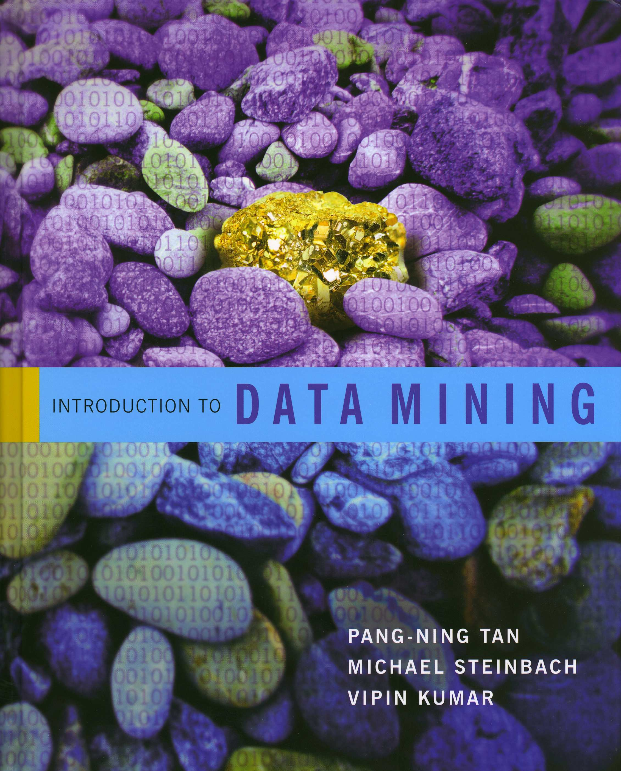
Introduction to Data Mining
by
Tan, Steinbach, Kumar
Chapter 2: Data

Slide 4

What is Data?
An attribute is a property or
characteristic of an object
Examples: eye color of a
person, temperature, etc.
Attribute is also known as variable,
field, characteristic, or feature
A collection of attributes describe an object
Object is also known as record, point, case, sample, entity, instance, or observation
Attributes
Objects

Slide 5
Working with Data in R
Creating Data:
> aa<-c(1,10,12)
> aa
[1] 1 10 12
Some simple operations:
> aa+10
[1] 11 20 22
> length(aa)
[1] 3

Slide 6
Working with Data in R
Creating More Data:
> bb<-c(2,6,79)
> my_data_set<-data.frame(attributeA=aa,attributeB=bb)
> my_data_set
attributeA attributeB
1 1 2
2 10 6
3 12 79

Slide 7
Working with Data in R
Indexing Data:
> my_data_set[,1]
[1] 1 10 12
> my_data_set[1,]
attributeA attributeB
1 1 2
> my_data_set[3,2]
[1] 79
> my_data_set[1:2,]
attributeA attributeB
1 1 2
2 10 6

Slide 8
Working with Data in R
Indexing Data:
> my_data_set[c(1,3),]
attributeA attributeB
1 1 2
3 12 79
Arithmetic:
> aa/bb
[1] 0.5000000 1.6666667 0.1518987

Slide 9
Working with Data in R
Summary Statistics:
> mean(my_data_set[,1])
[1] 7.666667
> median(my_data_set[,1])
[1] 10
> sqrt(var(my_data_set[,1]))
[1] 5.859465

Slide 10
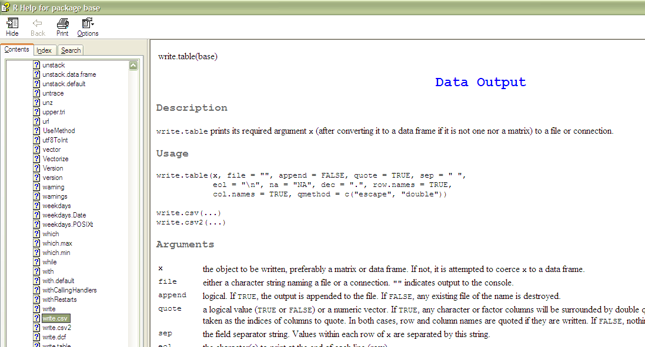
Working with Data in R
Writing Data:
> setwd("C:/Documents and Settings/David/Desktop")
> write.csv(my_data_set,"my_data_set_file.csv")
Help!:
> ?write.csv

Slide 11
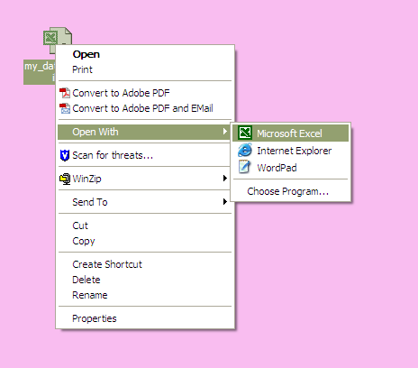
Working with Data in Excel
Reading in Data:

Slide 12
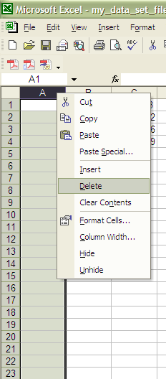
Working with Data in Excel
Deleting a Column:
(right click)

Slide 13
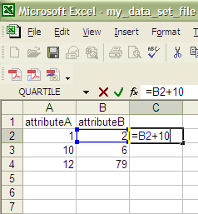
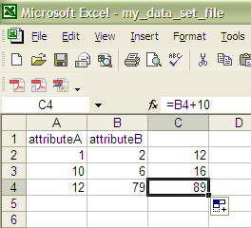
Working with Data in Excel
Arithmetic:

Slide 14
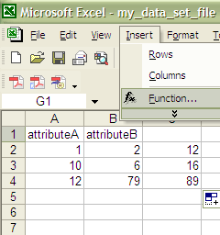
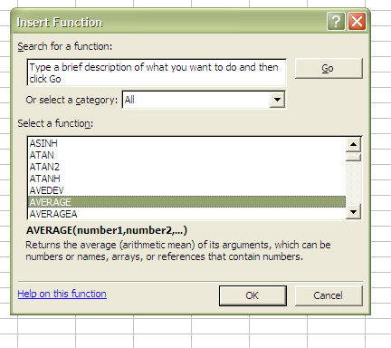
Working with Data in Excel
Summary Statistics: Use “Insert” then “Function” then “All” or “Statistical” to find an alphabetical list of functions

Slide 15
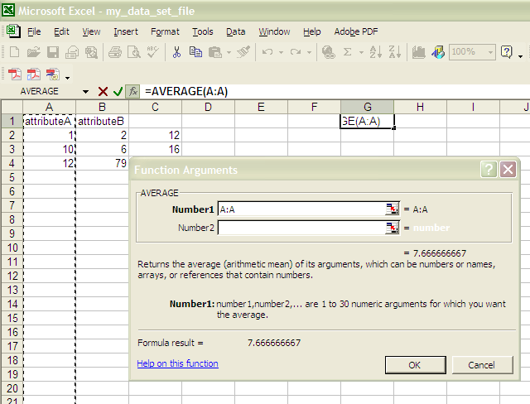
Working with Data in Excel
Summary Statistics: (Average)

Slide 16
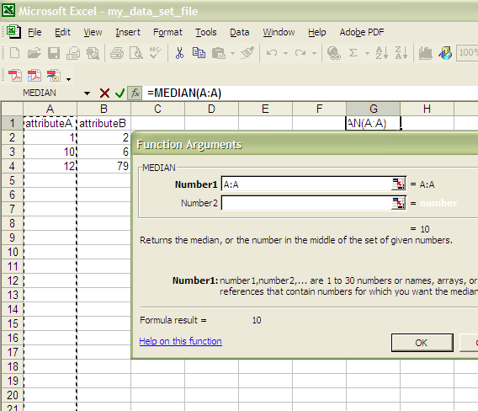
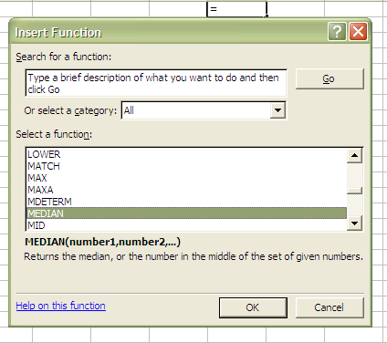
Working with Data in Excel
Summary Statistics: (Median)

Slide 17
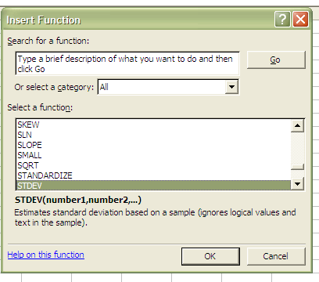
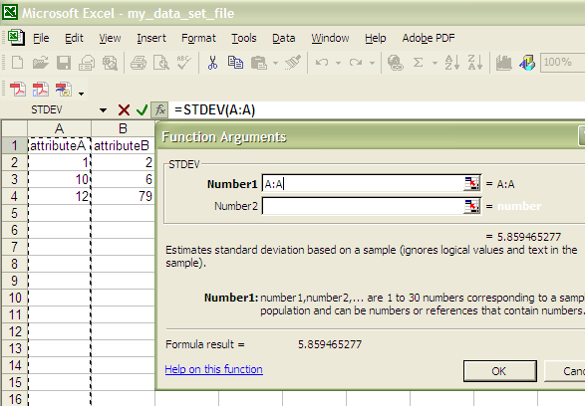
Working with Data in Excel
Summary Statistics: (Standard Deviation)

Slide 18
Sampling (P.47)
Sampling involves using only a random subset of the data for analysis
Statisticians are interested in sampling because they often can not get all the data from a population of interest
Data miners are interested in sampling because sometimes using all the data they have is too slow and unnecessary

Slide 19
Sampling (P.47)
The key principle for effective sampling is the following:
  using a sample will work almost as well as using the entire data sets, if the sample is representative
  a sample is representative if it has approximately the same property (of interest) as the original set of data

Slide 20
Sampling (P.47)
The simple random sample is the most common and basic type of sample
In a simple random sample every item has the same probability of inclusion and every sample of the fixed size has the same probability of selection
It is the standard “names out of a hat”
It can be with replacement (=items can be chosen more than once) or without replacement (=items can be chosen only once)
More complex schemes exist (examples: stratified sampling, cluster sampling, Latin hypercube sampling)

Slide 21
Sampling in Excel:
The function rand() is useful.
But watch out, this is one of the worst random number generators out there.
To draw a sample in Excel without replacement, use rand() to make a new column of random numbers between 0 and 1.
Then, sort on this column and take the first n, where n is the desired sample size.
Sorting is done in Excel by selecting “Sort” from the “Data” menu

Slide 22
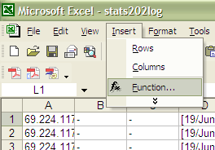
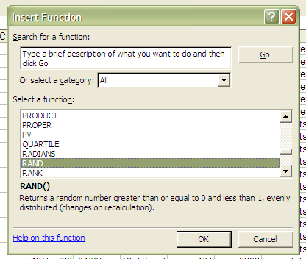
Sampling in Excel:

Slide 23
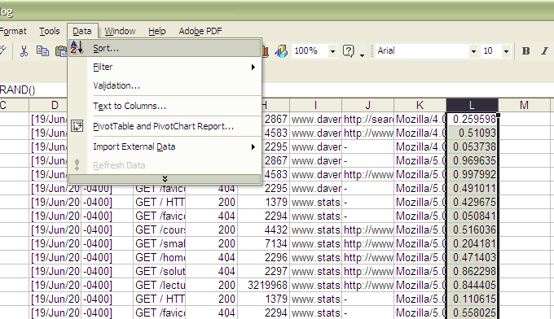
Sampling in Excel:

Slide 24
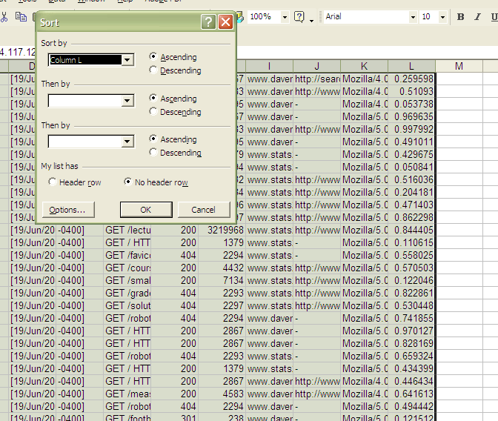
Sampling in Excel:

Slide 25
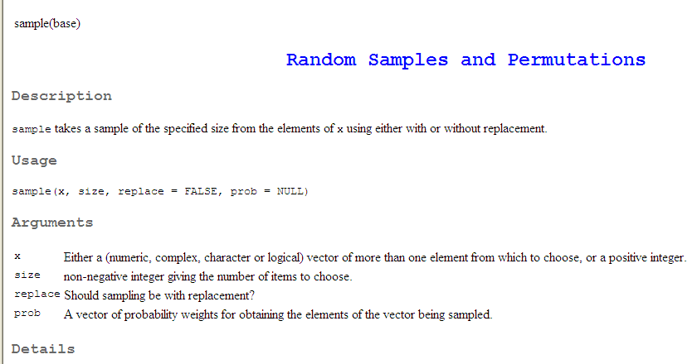
Sampling in R:
The function sample() is useful.

Slide 26
In class exercise #4:
Explain how to use R to draw a sample of 10 observations with replacement from the 7th column in the data set
http://www.cob.sjsu.edu/mease_d/stats202log.txt.

Slide 27
In class exercise #4:
Explain how to use R to draw a sample of 10 observations with replacement from the 7th column in the data set
http://www.cob.sjsu.edu/mease_d/stats202log.txt.
Answer:
> data<-read.csv("stats202log.txt",
sep=" ",header=F, na.strings = "-")
> sam<-sample(seq(1,1922),10,replace=T)
> my_sample<-data[sam,7]

Slide 28
In class exercise #5:
If you do the sampling in the previous exercise repeatedly, roughly how far is the mean of the sample from the mean of the whole column on average?

Slide 29
In class exercise #5:
If you do the sampling in the previous exercise repeatedly, roughly how far is the mean of the sample from the mean of the whole column on average?
Answer: about 26
> real_mean<-mean(data[,7])
> store_diff<-rep(0,10000)
>
> for (k in 1:10000){
+ sam<-sample(seq(1,1922),10,replace=T)
+ my_sample<-data[sam,7]
+ store_diff[k]<-abs(mean(my_sample)-real_mean)
+ }
> mean(store_diff)
[1] 25.75126

Slide 30
In class exercise #6:
If you change the sample size from 10 to 100, how does your answer to the previous question change?

Slide 31
In class exercise #6:
If you change the sample size from 10 to 100, how does your answer to the previous question change?
Answer: It becomes about 8.1
> real_mean<-mean(data[,7])
> store_diff<-rep(0,10000)
>
> for (k in 1:10000){
+ sam<-sample(seq(1,1922),100,replace=T)
+ my_sample<-data[sam,7]
+ store_diff[k]<-abs(mean(my_sample)-real_mean)
+ }
> mean(store_diff)
[1] 8.126843

Slide 32
The square root sampling relationship:
When you take samples, the differences between the sample values and the value using the entire data set scale as the square root of the sample size for many statistics such as the mean.
For example, in the previous exercises we decreased our sampling error by a factor of the square root of 10 (=3.2) by increasing the sample size from 10 to 100 since 100/10=10. This can be observed by noting 26/8.1=3.2.
Note: It is only the sizes of the samples that matter, and not the size of the whole data set.

Slide 33
Sampling (P.47)
Sampling can be tricky or ineffective when the data has a more complex structure than simply independent observations.
For example, here is a “sample” of words from a song. Most of the information is lost.
oops I did it again
I played with your heart
got lost in the game
oh baby baby
oops! ...you think I’m in love
that I’m sent from above
I’m not that innocent

Slide 34
Sampling (P.47)
Sampling can be tricky or ineffective when the data has a more complex structure than simply independent observations.
For example, here is a “sample” of words from a song. Most of the information is lost.
oops I did it again
I played with your heart
got lost in the game
oh baby baby
oops! ...you think I’m in love
that I’m sent from above
I’m not that innocent

Slide 35
Introduction to Data Mining
by
Tan, Steinbach, Kumar
Chapter 3: Exploring Data

Slide 36
Exploring Data
We can explore data visually (using tables or graphs) or numerically (using summary statistics)
Section 3.2 deals with summary statistics
Section 3.3 deals with visualization
We will begin with visualization
Note that many of the techniques you use to explore data are also useful for presenting data

Slide 37
Visualization
Page 105:
“Data visualization is the display of information in a graphical or tabular format.
Successful visualization requires that the data (information) be converted into a visual format so that the characteristics of the data and the relationships among data items or attributes can be analyzed or reported.
The goal of visualization is the interpretation of the visualized information by a person and the formation of a mental model of the information.”

Slide 38
Example:
  Below are exam scores from a course I taught once.
  Describe this data.
192 160 183 136 162 165 181 188 150 163 192 164 184 189 183 181 188 191 190 184 171 177 125 192 149 188 154 151 159 141 171 153 169 168 168 157 160 190 166 150
  Note, this data is at www.stats202.com/exam_scores.csv

Slide 39
The Histogram
Histogram (Page 111):
“A plot that displays the distribution of values for attributes by dividing the possible values into bins and showing the number of objects that fall into each bin.”
Page 112 – “A Relative frequency histogram replaces the count by the relative frequency”. These are useful for comparing multiple groups of different sizes.
The corresponding table is often called the frequency distribution (or relative frequency distribution).
The function “hist” in R is useful.

Slide 40
In class exercise #7:
Make a frequency histogram in R for the exam scores using bins of width 10 beginning at 120 and ending at 200.

Slide 41
In class exercise #7:
Make a frequency histogram in R for the exam scores using bins of width 10 beginning at 120 and ending at 200.
Answer:
> exam_scores<-
read.csv("exam_scores.csv",header=F)
> hist(exam_scores[,1],breaks=seq(120,200,by=10),
col="red",
xlab="Exam Scores", ylab="Frequency",
main="Exam Score Histogram")

Slide 42
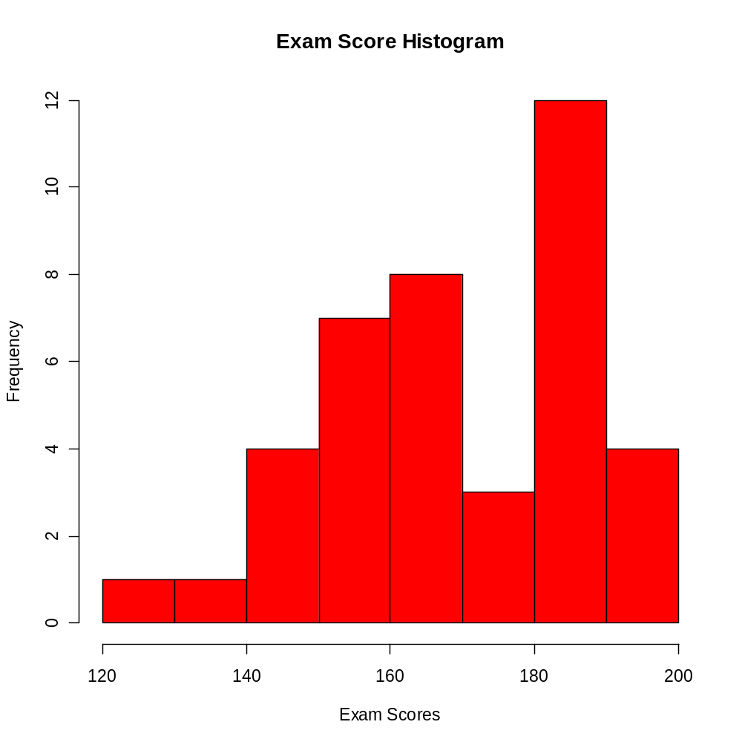
In class exercise #7:
Make a frequency histogram in R for the exam scores using bins of width 10 beginning at 120 and ending at 200.
Answer:

Slide 43
The (Relative) Frequency Polygon
Sometimes it is more useful to display the information in a histogram using points connected by lines instead of solid bars.
Such a plot is called a (relative) frequency polygon.
This is not in the book.
The points are placed at the midpoints of the histogram bins and two extra bins with a count of zero are often included at either end for completeness.

Slide 44
In class exercise #8:
Make a frequency polygon in R for the exam scores using bins of width 10 beginning at 120 and ending at 200.

Slide 45
In class exercise #8:
Make a frequency polygon in R for the exam scores using bins of width 10 beginning at 120 and ending at 200.
Answer:
> my_hist<-hist(exam_scores[,1],
breaks=seq(120,200,by=10),plot=FALSE)
> counts<-my_hist$counts
> breaks<-my_hist$breaks
> plot(c(115,breaks+5),
c(0,counts,0),
pch=19,
xlab="Exam Scores",
ylab="Frequency",main="Frequency Polygon")
> lines(c(115,breaks+5),c(0,counts,0))

Slide 46
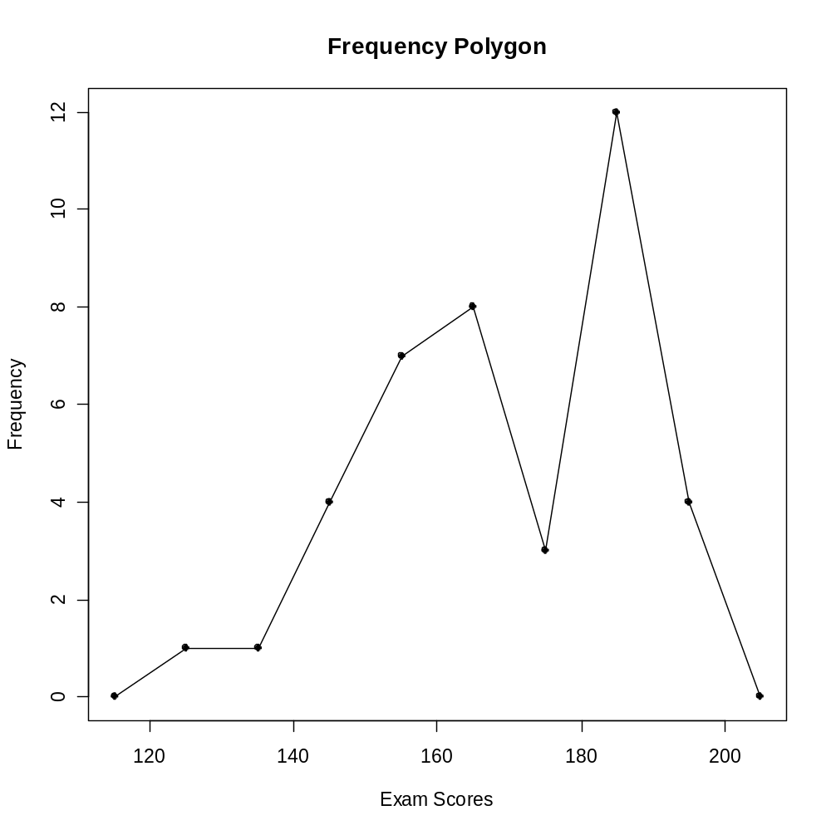
In class exercise #8:
Make a frequency polygon in R for the exam scores using bins of width 10 beginning at 120 and ending at 200.
Answer:

Slide 47
The Empirical Cumulative Distribution Function (Page 115)
“A cumulative distribution function (CDF) shows the probability that a point is less than a value.”
“For each observed value, an empirical cumulative distribution function (ECDF) shows the fraction of points that are less than this value.” (Page 116)
A plot of the ECDF is sometimes called an ogive.
The function “ecdf” in R is useful. The plotting features are poorly documented in the help(ecdf) but many examples are given.

Slide 48
In class exercise #9:
Make a plot of the ECDF for the exam scores using the function “ecdf” in R.

Slide 49
In class exercise #9:
Make a plot of the ECDF for the exam scores using the function “ecdf” in R.
Answer:
> plot(ecdf(exam_scores[,1]),
verticals= TRUE,
do.p = FALSE,
main ="ECDF for Exam Scores",
xlab="Exam Scores",
ylab="Cumulative Percent")

Slide 50
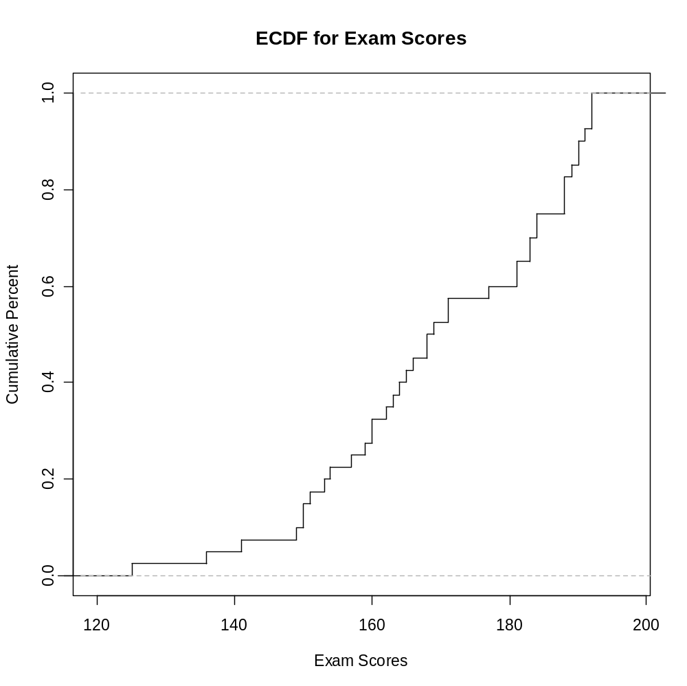
In class exercise #9:
Make a plot of the ECDF for the exam scores using the function “ecdf” in R.
Answer:

Slide 51
Comparing Multiple Distributions
If there is a second exam also scored out of 200 points, how will I compare the distribution of these scores to the previous exam scores?
187 143 180 100 180
159 162 146 159 173
151 165 184 170 176
163 185 175 171 163
170 102 184 181 145
154 110 165 140 153
182 154 150 152 185
140 132
Note, this data is at www.stats202.com/more_exam_scores.csv

Slide 52
Comparing Multiple Distributions
Histograms can be used, but only if they are relative frequency histograms.
Relative Frequency Polygons are even better. You can use a different color/type line for each group and add a legend.
Plots of the ECDF are often even more useful, since they can compare all the percentiles simultaneously. These can also use different color/type lines for each group with a legend.

Slide 53
In class exercise #10:
Plot the relative frequency polygons for both the first and second exams on the same graph. Provide a legend.

Slide 54
In class exercise #10:
Plot the relative frequency polygons for both the first and second exams on the same graph. Provide a legend.
Answer:
> more_exam_scores<-
read.csv("more_exam_scores.csv",header=F)
> my_new_hist<- hist(more_exam_scores[,1],
breaks=seq(100,200,by=10),plot=FALSE)
> new_counts<-my_new_hist$counts
> new_breaks<-my_new_hist$breaks
> plot(c(95,new_breaks+5),c(0,new_counts/37,0),
pch=19,xlab="Exam Scores",
ylab="Relative Frequency",main="Relative
Frequency Polygons",ylim=c(0,.30))
> lines(c(95,new_breaks+5),c(0,new_counts/37,0),
lty=2)

Slide 55
In class exercise #10:
Plot the relative frequency polygons for both the first and second exams on the same graph. Provide a legend.
Answer (Continued):
> points(c(115,breaks+5),c(0,counts/40,0),
col="blue",pch=19)
> lines(c(115,breaks+5),c(0,counts/40,0),
col="blue",lty=1)
> legend(110,.25,c("Exam 2","Exam 1"),
col=c("black","blue"),lty=c(2,1),pch=19)

Slide 56
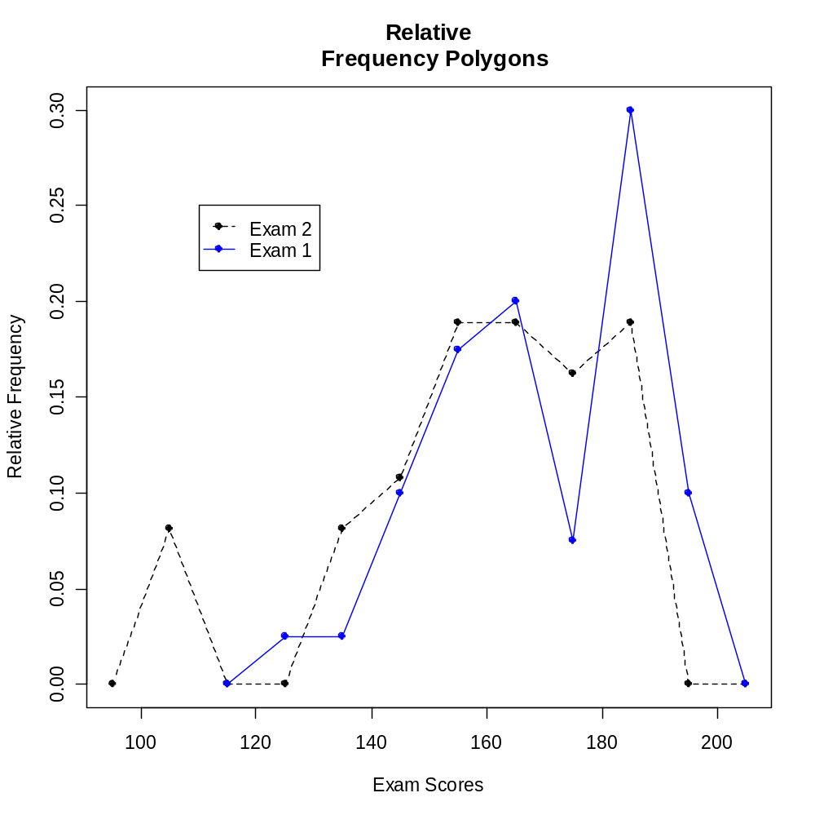
In class exercise #10:
Plot the relative frequency polygons for both the first and second exams on the same graph. Provide a legend.
Answer (Continued):

Slide 57
In class exercise #11:
Plot the ECDF for both the first and second exams on the same graph. Provide a legend.

Slide 58
In class exercise #11:
Plot the ECDF for both the first and second exams on the same graph. Provide a legend.
Answer:
> plot(ecdf(exam_scores[,1]),
verticals= TRUE,do.p = FALSE,
main ="ECDF for Exam Scores",
xlab="Exam Scores",
ylab="Cumulative Percent",
xlim=c(100,200))
> lines(ecdf(more_exam_scores[,1]),
verticals= TRUE,do.p = FALSE,
col.h="red",col.v="red",lwd=4)
> legend(110,.6,c("Exam 1","Exam 2"),
col=c("black","red"),lwd=c(1,4))

Slide 59
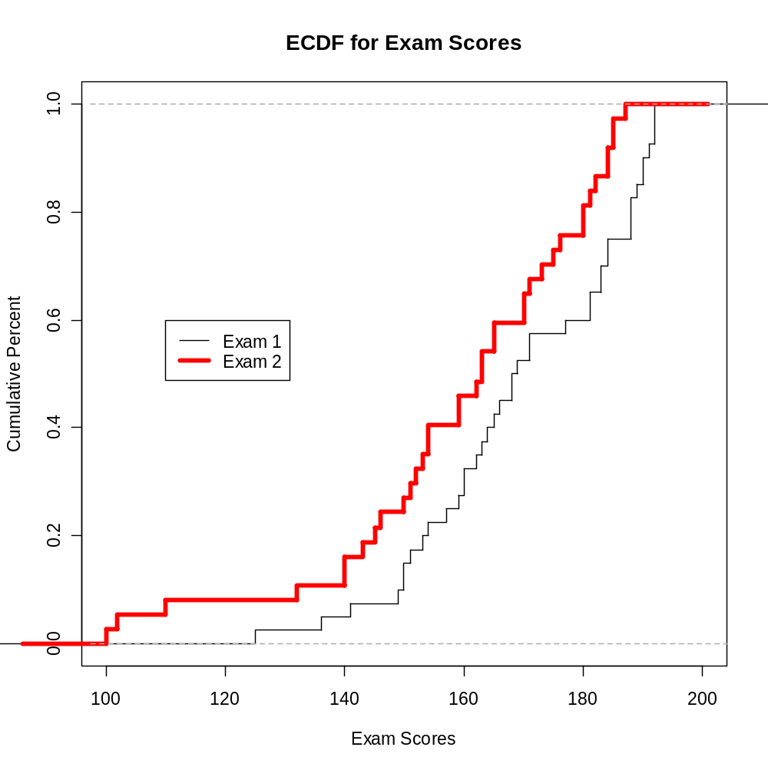
In class exercise #11:
Plot the ECDF for both the first and second exams on the same graph. Provide a legend.
Answer:

Slide 60
In class exercise #12:
Based on the plot of the ECDF for both the first and second exams from the previous exercise, which exam has lower scores in general? How can you tell from the plot?

Slide 61
Visualizing Paired Numeric Data
The two sets of exam scores in the previous exercise were not paired. However, the data at www.stats202.com/exams_and_names.csv contains the same exam scores along with an identifier of the student. This data is paired.
For visualizing paired numeric data, scatter plots (Page 116) are extremely useful. These can be produced using the plot() command in R.
When the data set has two or more numeric attributes, examining scatter plots of all possible pairs is often useful. The function pairs() in R does this for you. The book calls this a scatter plot matrix (Page 116).

Slide 62
In class exercise #13:
Use R to make a scatter plot of the exam scores at www.stats202.com/exams_and_names.csv with the first exam on the x-axis and the second exam on the y-axis. Scale the x-axis and y-axis both from 100 to 200. Add the diagonal line (y=x) to the plot. What does this plot reveal?

Slide 63
In class exercise #13:
Use R to make a scatter plot of the exam scores at www.stats202.com/exams_and_names.csv with the first exam on the x-axis and the second exam on the y-axis. Scale the x-axis and y-axis both from 100 to 200. Add the diagonal line (y=x) to the plot. What does this plot reveal?
Answer:
data<-read.csv("exams_and_names.csv")
plot(data$Exam.1,data$Exam.2,
xlim=c(100,200),ylim=c(100,200),
pch=19,
main="Exam Scores",xlab="Exam 1",ylab="Exam 2")
abline(c(0,1))

Slide 64
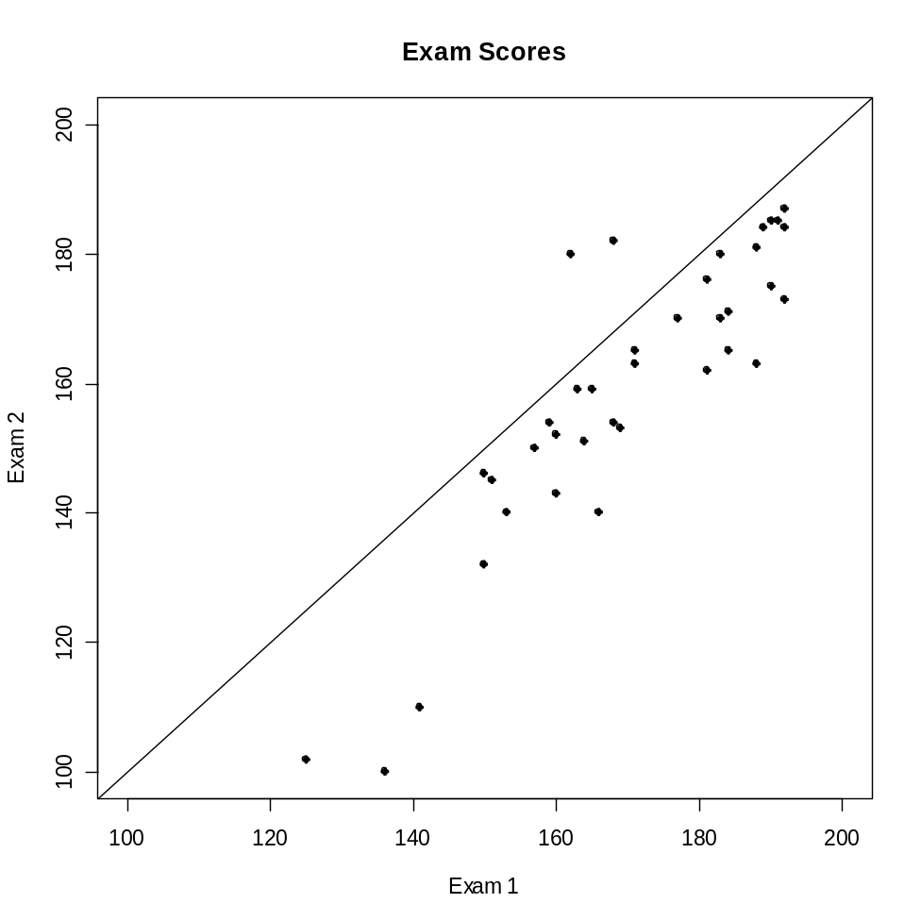
In class exercise #13:
Use R to make a scatter plot of the exam scores at www.stats202.com/exams_and_names.csv with the first exam on the x-axis and the second exam on the y-axis. Scale the x-axis and y-axis both from 100 to 200. Add the diagonal line (y=x) to the plot. What does this plot reveal?
Answer:

Slide 65
Labeling Points on a Scatter Plot
The R commands text() and identify() are useful for labeling points on the scatter plot.

Slide 66
In class exercise #14:
Use the text() command in R to label the points for the students who scored lower than 150 on the first exam. Use the identify command to label the points for the two students who did better on the second exam than the first exam. Use the first column in the data set for the labels.

Slide 67
In class exercise #14:
Use the text() command in R to label the points for the students who scored lower than 150 on the first exam. Use the identify command to label the points for the two students who did better on the second exam than the first exam. Use the first column in the data set for the labels.
Answer:
text(data$Exam.1[data$Exam.1<150],
data$Exam.2[data$Exam.1<150],
labels=data$Student[data$Exam.1<150],adj=1)
identify(data$Exam.1,data$Exam.2,
labels=data$Student)

Slide 68
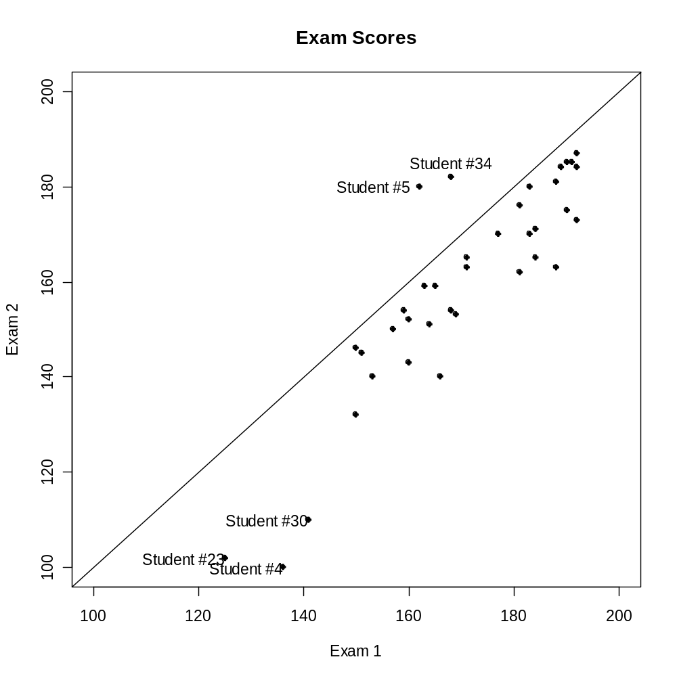
In class exercise #14:
Use the text() command in R to label the points for the students who scored lower than 150 on the first exam. Use the identify command to label the points for the two students who did better on the second exam than the first exam. Use the first column in the data set for the labels.

Slide 69
Adding Noise to a Scatter Plot
When both variables are discrete, many points in a scatter plot may be plotted over top of one another, which tends to skew the relationship.
A solution is to add a small amount of noise to the points so that they are jittered a little bit.
Note: If you have too many points to display cleanly on a scatter plot, sampling may also be helpful.

Slide 70
In class exercise #15:
Add noise uniformly distributed on the interval -0.5 to 0.5 to both the x and y values in the graph in the previous exercise.

Slide 71
In class exercise #15:
Add noise uniformly distributed on the interval -0.5 to 0.5 to both the x and y values in the graph in the previous exercise.
Answer:
data$Exam.1<-data$Exam.1+runif(40)-.5
data$Exam.2<-data$Exam.2+runif(40)-.5
(then same as before)

Slide 72
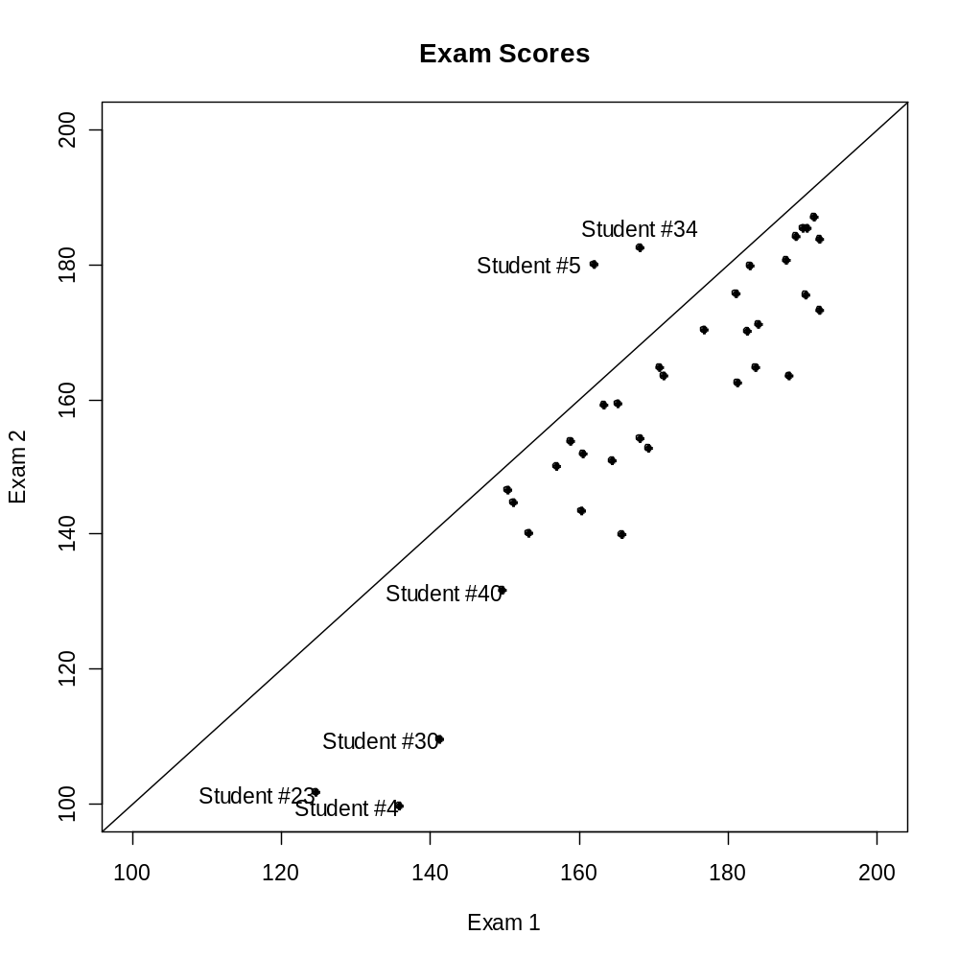
In class exercise #15:
Add noise uniformly distributed on the interval -0.5 to 0.5 to both the x and y values in the graph in the previous exercise.

